Slide 1
Reviewer #2
The second assumption is that the early noise remains constant as the distracter value increases. This assumption is unrealistic and inconsistent with the authors’ own experimental data (Fig. 3f).
Now, this is not all bad. Perhaps it is the case that these positive distracter effects only occur in settings where noise doesn’t scale with value. It would be useful to discuss whether that is likely the case in the studies that find the positive distracter effect. Better yet would be an experiment that imposes equal (or lower) variance for higher values.
The problem is that the authors’ experiment does have variance that increases with value. When we consider Figure 4d, as we move from left to right we must also jump to redder curves. Judging from the figure, the latter effect will swamp the former effect and accuracy will decrease. Perhaps the authors could take the relationship in Figure 3f and incorporate it into their model/simulations. If the model can still produce positive effects of distracter value on accuracy, that would be much more convincing.

Slide 2
Supplementary Figure 2

Slide 3
Distracters from the data (Mean-scaled noise) Assumed targets (V1, V2, sd1, sd2)
V1 = 93, V2 = 83, sd1 = sd2 = 9

Slide 4
Model Fitting individually (Over-fitting convern)
Model 1
Model 2
Model 3
Model 4

Slide 5
Model Fitting individually (Over-fitting convern)
Model 1
Model 2
Model 3
Model 4

Slide 6
Fit the pooled data with a signal set of parameters
Model 1
Model 2
Model 3
Model 4

Slide 7
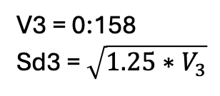
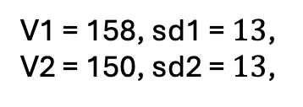
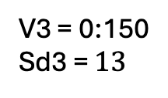
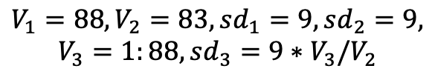
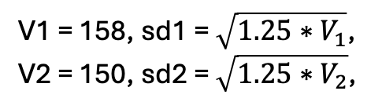
Old simulation from Python
New simulation from Matlab
$$V_{1}=88, V_{2}=83, sd_{1}=9, sd_{2}=9,$$
$$V_{3}=1:88, sd_{3}=9∗V_{3}/V_{2}$$
Mean-scaled noise
Constant noise
V1 = 158, sd1 = $\sqrt{1.25∗V_{1}}$,
V2 = 150, sd2 = $\sqrt{1.25∗V_{2}}$,
V1 = 158, sd1 = $13$,
V2 = 150, sd2 = $13$,
V3 = 0:158
Sd3 = $\sqrt{1.25∗V_{3}}$
V3 = 0:150
Sd3 = $13$

